Slide 1
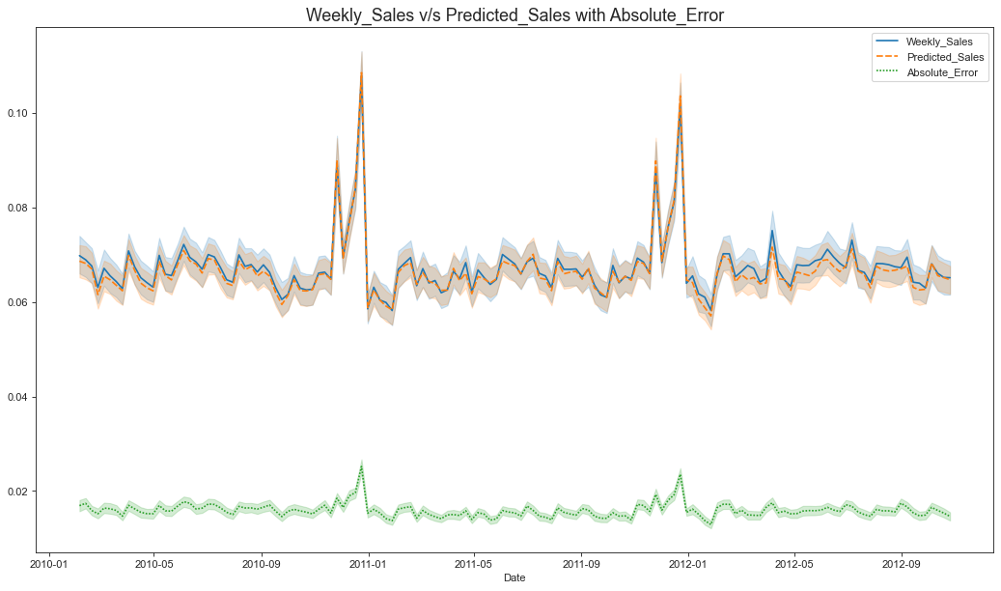
Sale Forcasting & Anomaly Detection on Walmart Dataset
Under the supervision of
Dr. Soumitra Samanta
Department of Computer Science
RKMVERI, Belur

Slide 2
Introduction
What is forecasting ?
A technique that takes historical data as inputs to estimate the future values or trends.
What is anomaly inside a data?
Data points, events or observations that deviate from a datasets normal behaviour.
Why is it important?
An online retail business must predict which discounts, events or new products, may trigger boosts in sales which will increase demand on their web servers.
IT security team must prevent hacking and needs to detect abnormal login patterns and user behaviors.
Identifying abnormal Heartbeats ECG graphs

Slide 3
Motivation
The reason to select time dependent data is, they are one of the most occurring real world data. Again in real life situation most of the datas are not labeled as anomaly or non-anomaly . So considering the real life situation I choose the dataset.
The Main Objective of forecasting is to predict sales of store in a week.
The objective of Unsupervised Anomaly Detection is to detect previously unseen rare objects or events without any prior knowledge.

Slide 4
A bit about the data set
An American multinational retail corporation that operates a chain of hypermarkets, discount department stores, and grocery stores from the United States.
I took ‘Walmart’ dataset from data.world.
It contains historical sales data for 45 Walmart stores located in different regions.
Each store contains a number of departments (uniquely 81)

Slide 5
Forecasting
In the first phase I do some data manupulations and do some feature engineering. After the data set has been ready I have implemented some machine learning algorithms.
I have started with random forest regressor and get the accuracy near about 76%.
Then I have implemented more treditional Machine Learning Regression techniques.
Their accuracies as follows:

Slide 6
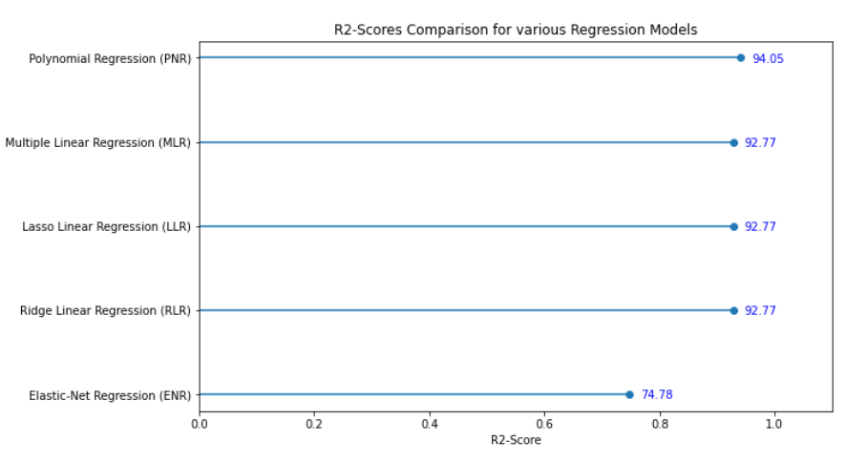
R2 score of Several Regressors:

Slide 7
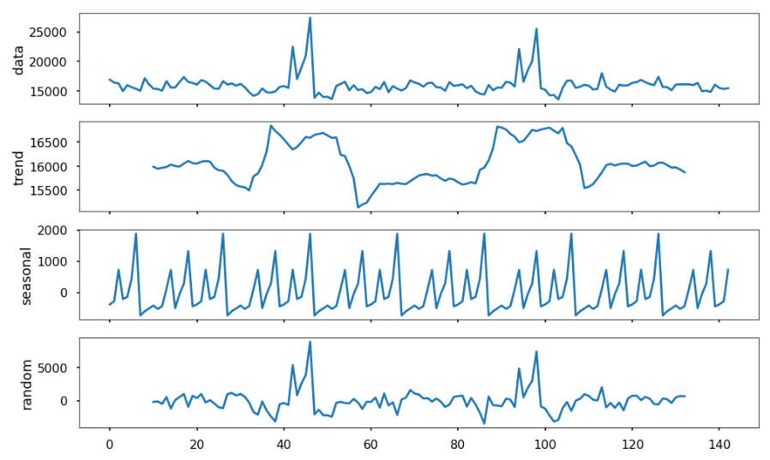
Time Series Forecasting of the data:
First I have done a time series decomposition of the average sale of the dataset to see its various components.
Then I make it stationary
by differencing methods.
Finally fitted the data into an
ARIMA model.
The best model turns out
ARIMA(3,0,2).

Slide 8
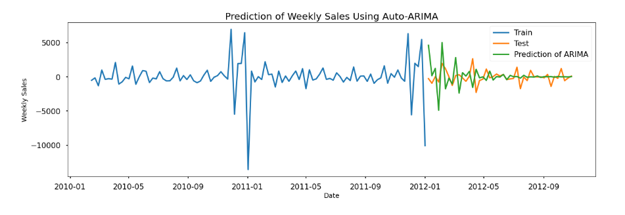
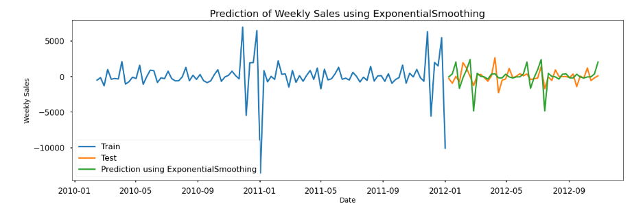
Time Series Forecasting Results:

Slide 9
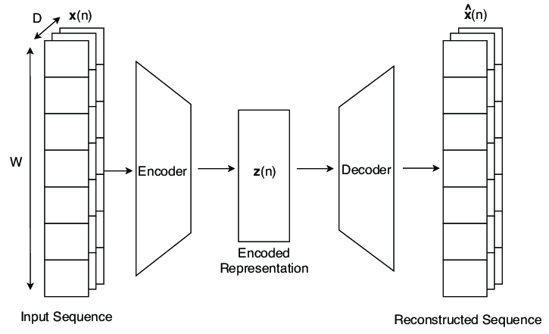
Anomaly Detection:
Algorithms I have implemented to detect anomalies:
KNN Regressor
DBSCAN
LSTM with Auto-Encoders
Finally Model which I have selected:
LSTM with Auto-Encoders
Source

Slide 10
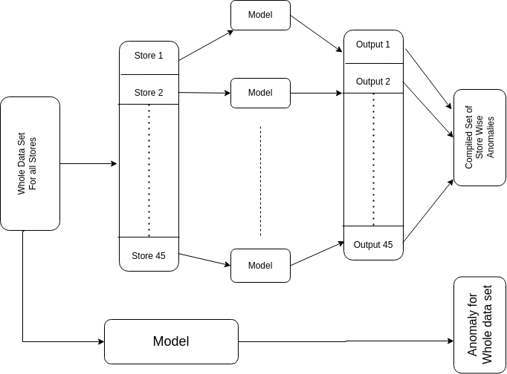
Outline

Slide 11
Algorithms we’ve used to detect the anomalies
DBSCAN
KNN Regressor
LSTM

Slide 12
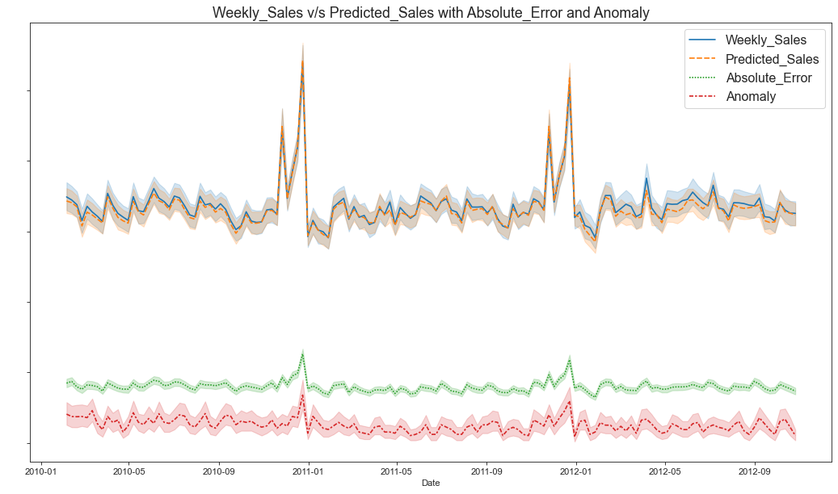
KNN Regressor
Though KNN Regressor predicting the sales with a good accuracy but the threshold methods we are using to detect the anomalies is giving us some error.

Slide 13
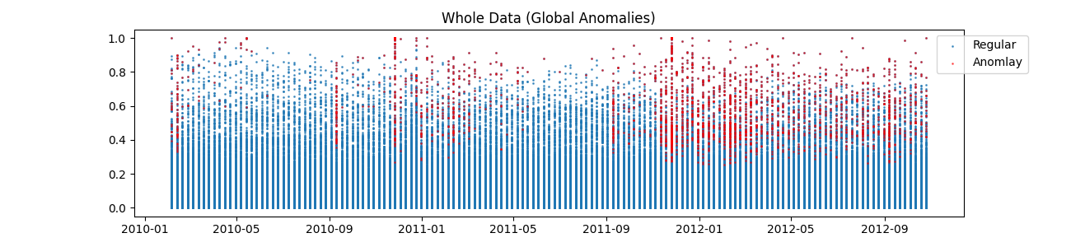

DBSCAN
Depends on epsilon (radius of hypersphere) and minimum samples.
Based on these parameters, the algorithm determines whether certain values in the dataset are outliers or not.

Slide 14
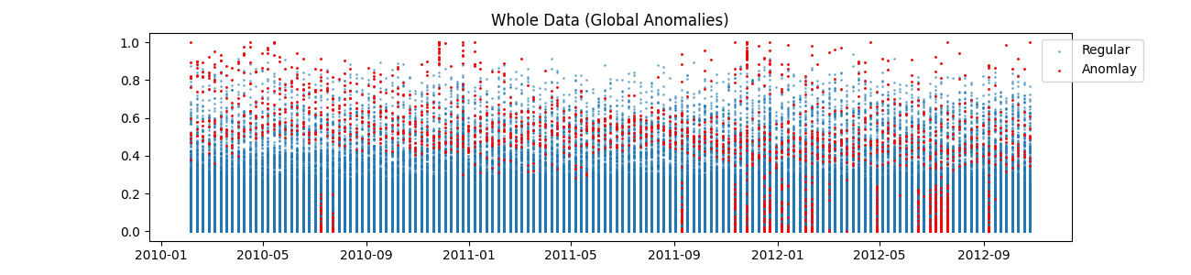
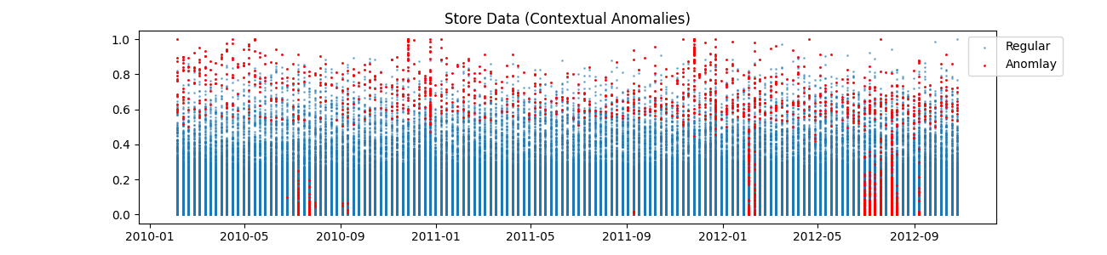
LSTM AutoEncoder
Unlike ARIMA or Prophet, this does not rely on specific assumptions about the data such as time series stationarity or the existence of a Date field.

Slide 15
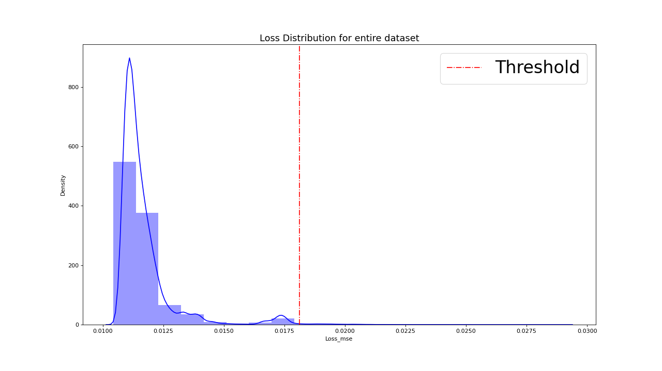
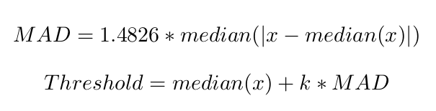
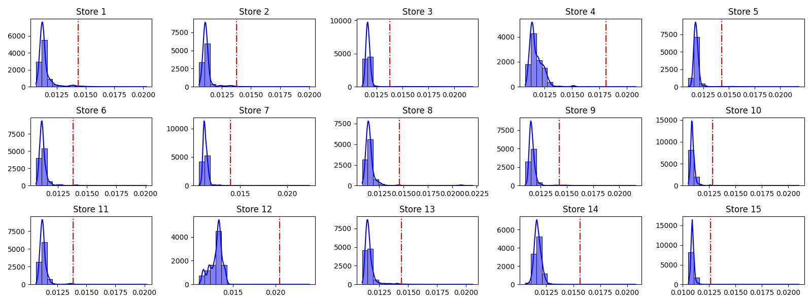
Threshold
Where, k is a constant, we took k = 13
MAD (Median absolute deviation) is a robust measure for detecting anomalies

Slide 16
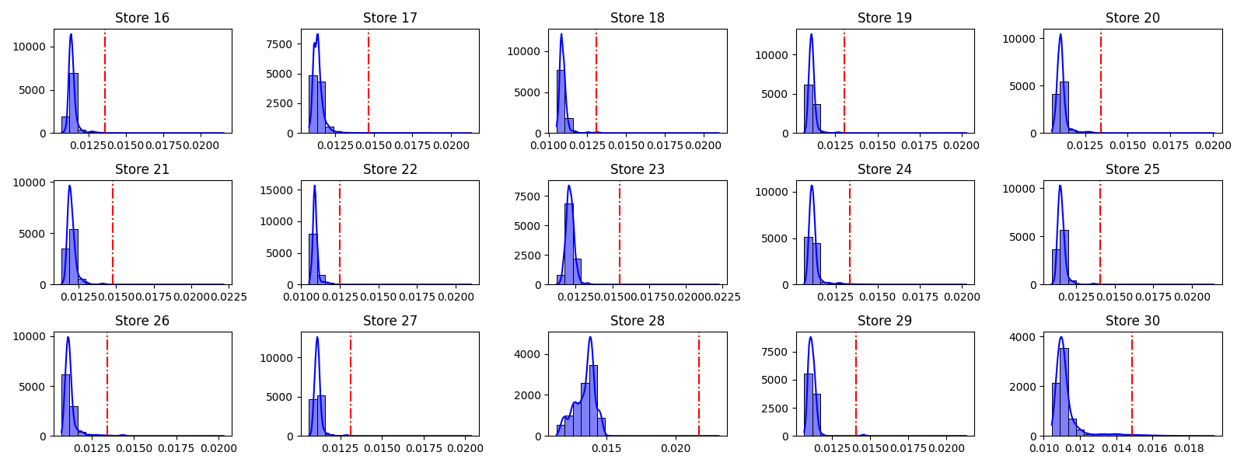
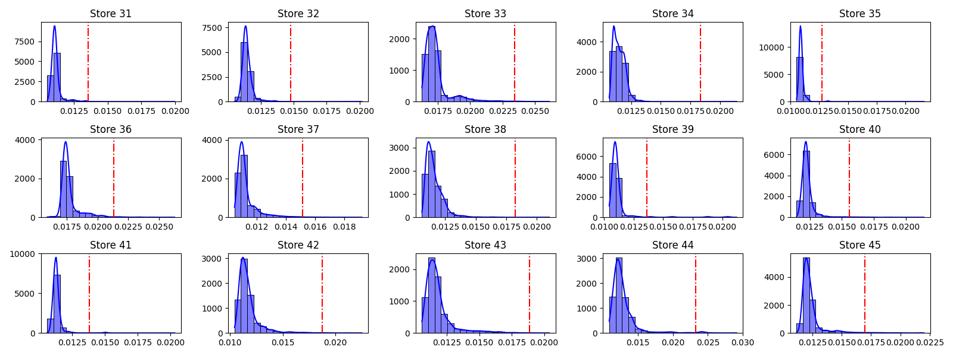

Slide 17
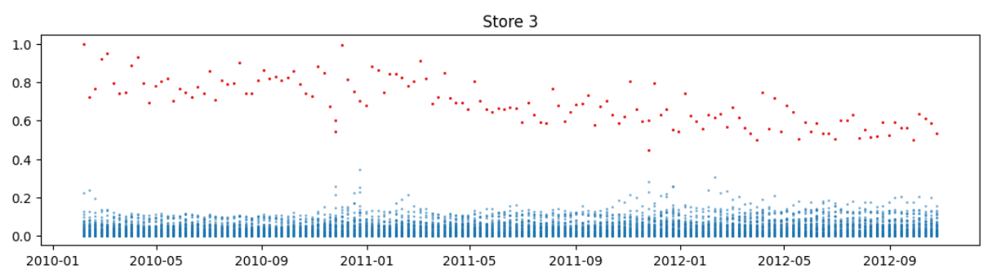
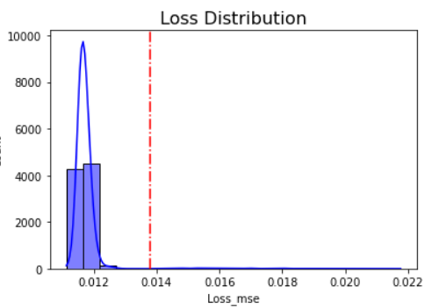
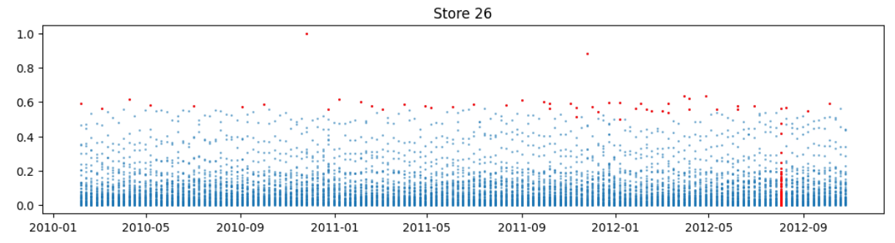
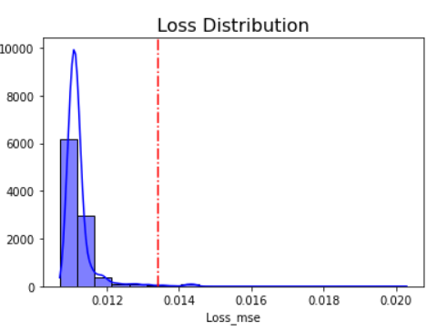

Slide 18
Comparison
Model | Store Wise | Whole Data
DBSCAN | 2257 (0.54%) | 2263 (0.54%)
LSTM | 2239 (0.53%) | 2365 (0.56%)

Slide 19
Reference
Pasi Fr¨anti Jiawei Yang, Susanto Rahardja.Outlier detection: how to threshold outlier scores?
(https://www.researchgate.net/publication/337883760_Outlier_detection_how_to_threshold_outlier_scores, 2016)
Gloria Wang Benjamin Smith, Kevin Cant. Anomaly detection with sdae. (https://arxiv.org/pdf/2004.04391.pdf, 2016)
Ihssan Tinawi. Machine learning for time series anomaly detection.
(https://hdl.handle.net/1721.1/123129, 2016.)

Slide 20
Thank You
The End

